Slide 1
Stock Market’s Price Movement Prediction With LSTM Neural Networks
Isye6785 Class Presentation – Weifeng Lyu
Notes:
This final presentation will discuss stock market’s price movement prediction with long short time memory neural networks. First, I would like to present the paper that I will discuss, this paper is written by three authors in UFMG in Brazil. It focuses on price predictions on stock markets with chaotic and dynamic environment. This paper introduces machine learning approaches, mainly long short time memory networks to resolve the scenario, predict the future trends of stock prices based on the historical data.

Slide 2
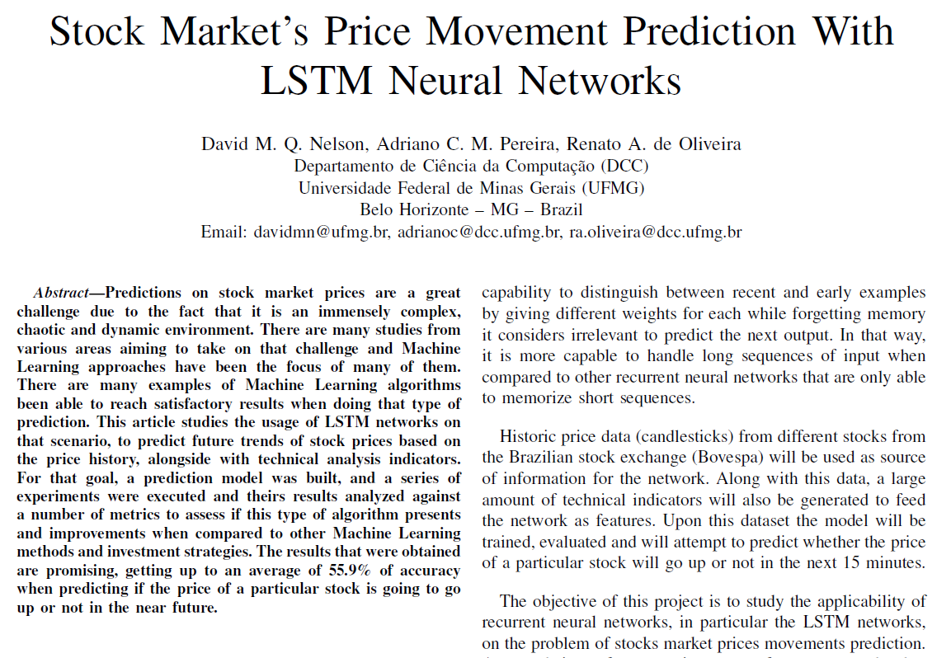

Slide 3
OutLine
Recurrent Neural Networks
How does RNN works
How Long Short-Term Memory works in stock market
Methodology & Development
Evaluation
Conclusion

Slide 4
Recurrent neutral networks
A recurrent neural network (RNN) is a class of artificial neural network where connections between nodes form a directed graph along a sequence.
“Learn what’s going to happen after historical data”
Applications:
Stock Prediction
Sequence Generation
Text Generation
Voice Recognition
Notes:
The first example is stock prediction. Because stock prediction, price of today depends a lot on price of yesterday, or the price of two days ago. Things like sequence generation, whenever the data follows a certain sequence, things like text generation, when we are typing any message, the phone will guess the next word significantly depending on the last word. Things like Voice recognition, when we have sound coming in, it also has the previous words, so we have two components where the information comes in in order to guess the next word. I hope this will give some ideas of how recurrent neural network applies.

Slide 5
OutLine
Recurrent Neural Networks
How does RNN works
How Long Short-Term Memory works in stock market
Methodology & Development
Evaluation
Conclusion

Slide 6
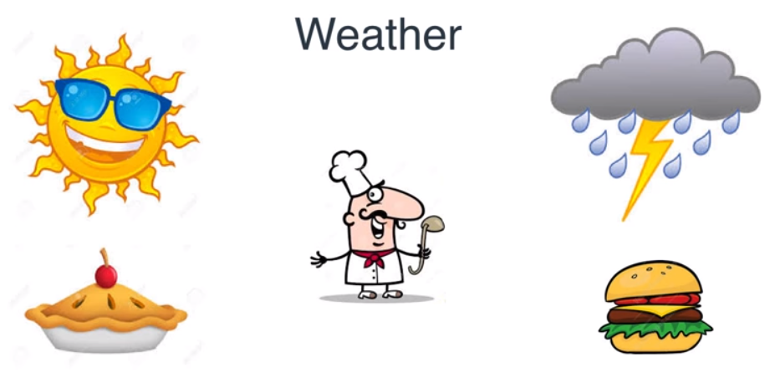
A Simple Recurrent Neural network
If input == sunny, then output = apple pie
If input == rainy, then output = burger
Notes:
In this case, we have a roommate who cooks food everyday depending on the weather, so the input is weather (sunny day, rainy day), the output is the food he cooks (apple pie, burger). This scenario can be easily modelled by simple neural network.

Slide 7
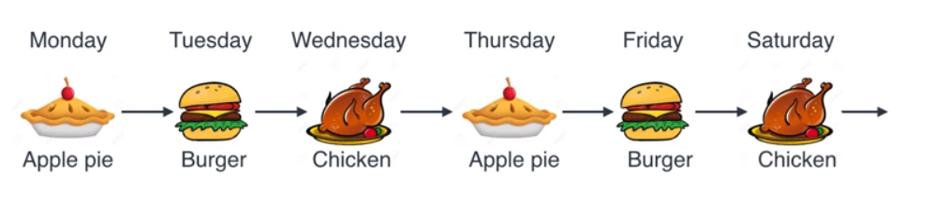
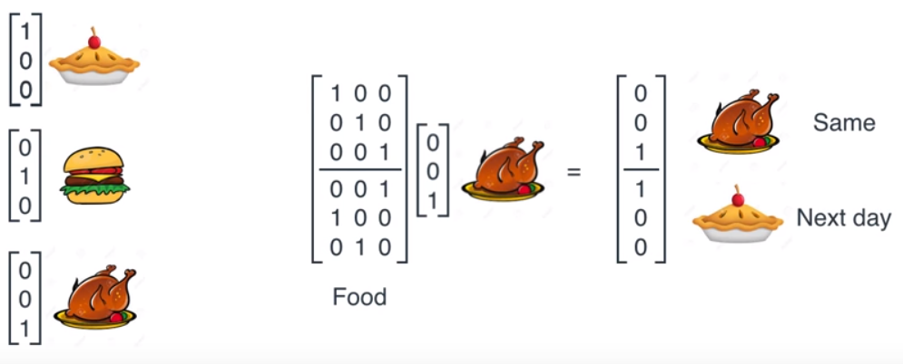
A Simple Neural network
If yesterday’s output == apple pie, then next output = burger
If yesterday’s output == burger, then next output = chicken
If yesterday’s output == chicken, then next output = apple pie
Notes:
Let’s make this situation more complicated. Now my roommate wants to cook different food every other day. That means the food cook for today depends on the food cook for yesterday. Therefore, the food cook for yesterday will be an input of the neural network, the food cook for today is the output of the neural network. We can simply use vectors representing apple pie, [1 0 0], burger, [0 1 0], and chicken [0 0 1], and setup a matrix for neural network to get today’s food and next day’s food based on the input of today’s food. This is the sequential example of recurrent neural network.

Slide 8
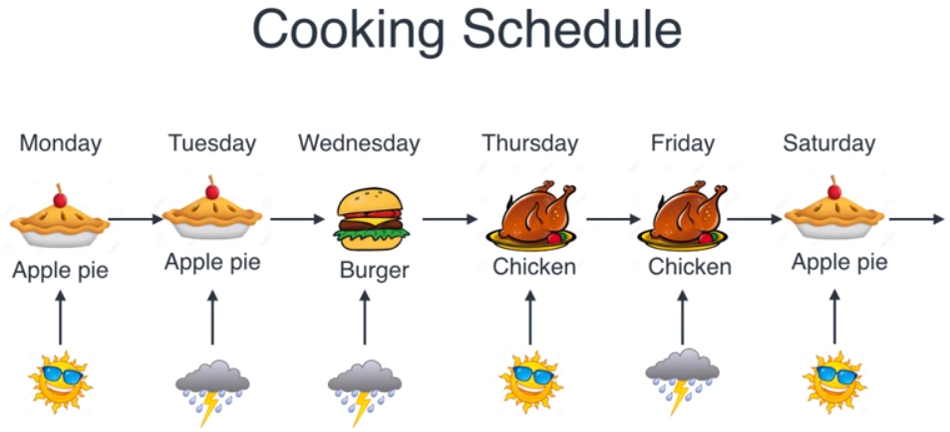
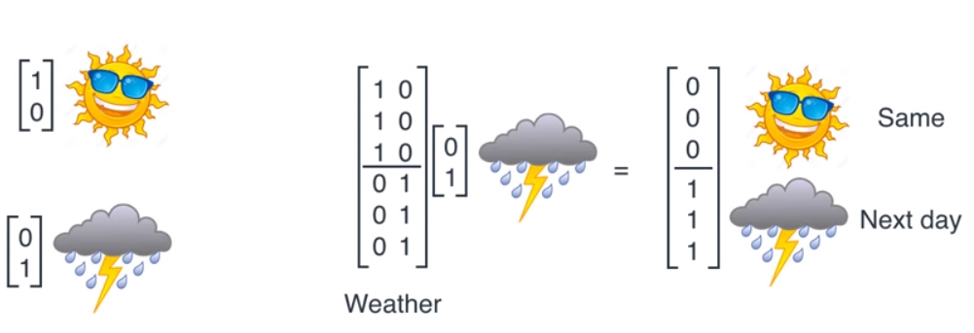
A Simple Neural network
If input == sunny, then output = yesterday’s output
If input == rainy, then output = yesterday’s next output
Notes:
Now let’s change the rule again, now his rule for cooking is the combination of previous two. If sunny, he will cook the same thing as yesterday’s, if rainy, he will cook the next thing in the sequence. We can perform multiplication of weather input with weather matrix, which gives another matrix that indicates we should cook the same food or next day’s food.

Slide 9
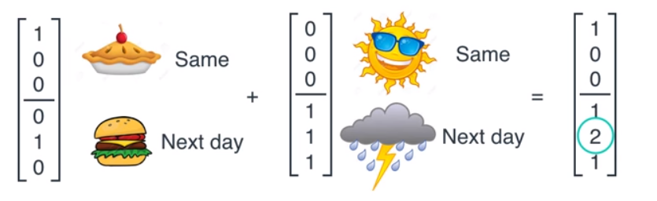
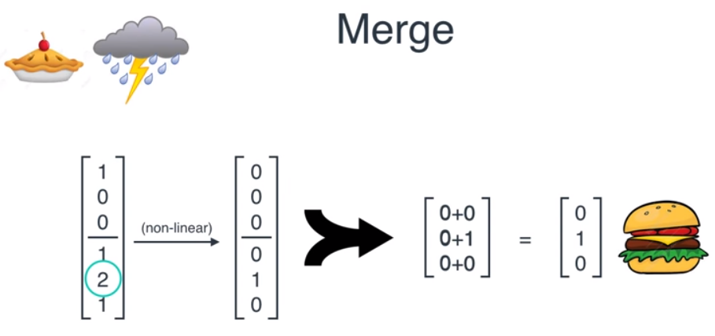
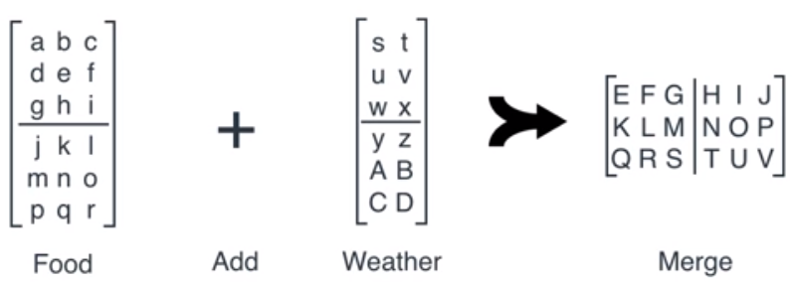
A Simple Neural network
Notes:
After we get two matrix, one is the food for today and the food for tomorrow, the other matrix is tomorrow should cook the same food or next day’s food, we simply add these two matrix to get tomorrow’s food. We can eliminate all values to be zero except the maximum:2, so we finally get [0 1 0] to represent burger for the next day’s food.
Our neural network really depends only on these parameters. These parameters are important components to make the model work well. The way we get started is to train them with some random weights so imagine if ABCDEF and all the way to capital V are random numbers, and we train them using gradient descent. How the gradient descent works is that you have some parameters and you have an error given by your data, so you fit in your data to your neural network and it gives you a big error, and you do steps to reduce this error slowly. The error function will be distinct based on different scenarios and models you use.

Slide 10
OutLine
Recurrent Neural Networks
How does RNN works
How Long Short-Term Memory works in stock market
Methodology & Development
Evaluation
Conclusion

Slide 11
How Long Short-Term Memory works in stock market
A popular method of modeling and predicting the stock market is technical analysis, which is a method based on historic data from the market, mainly price and volume. It follows some assumptions:
prices are defined exclusively by the supply-demand relation;
prices change following tendencies;
changes on supply and demand cause tendencies to reverse;
changes on supply and demand can be identified on charts;
patterns on charts tend to repeat
technical analysis do not take into account any external factors like political, social or macro-economical.
Notes:
Long Short Term Memory networks – usually just called “LSTMs” – are a special kind of RNN, capable of learning long-term dependencies. They were introduced by Hochreiter & Schmidhuber (1997), and were refined and popularized by many people in following work. They work tremendously well on a large variety of problems, and are now widely used.
LSTMs are explicitly designed to avoid the long-term dependency problem. Remembering information for long periods of time is practically their default behavior, not something they struggle to learn!

Slide 12



Long short term memory neural network
Notes:
All recurrent neural networks have the form of a chain of repeating modules of neural network. In standard RNNs, this repeating module will have a very simple structure, such as a single tanh layer. LSTMs also have this chain like structure, but the repeating module has a different structure. Instead of having a single neural network layer, there are four, interacting in a very special way. In the above diagram, each line carries an entire vector, from the output of one node to the inputs of others. The pink circles represent pointwise operations, like vector addition, while the yellow boxes are learned neural network layers. Lines merging denote concatenation, while a line forking denote its content being copied and the copies going to different locations.
Recurrent networks differ from the traditional feed-forward networks in the sense that they don’t only have neural connections on a single direction, in other words, neurons can pass data to a previous or the same layer. In which case, data doesn’t flow on a single way, and the practical effects for that is the existence of short term memory, in addition to long term memory that neural networks already
have in consequence of training. LSTM aimed for a better performance by tackling the vanishing gradient issue that recurrent networks would suffer when dealing with long data sequences. It does so by keeping the error flow constant through special units called ”gates” which allows for weights adjustments as well as truncation of the gradient when its information is not necessary.

Slide 13
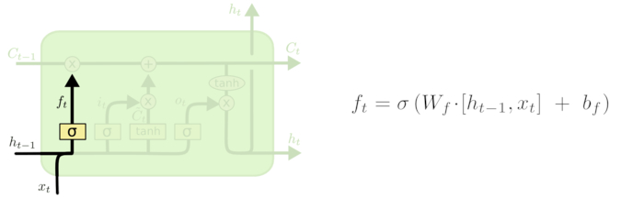
Forget gate
Determine what information the cell should forget:
Ft = 1~0
Ft = 1 means completely reserved, Ft = 0 means completed forgot
Ht-1 = the output of the last cell
Xt-1 = the input of current cell
Sigma = sigmod function
Notes:
The first step in our LSTM is to decide what information we’re going to throw away from the cell state. This decision is made by a sigmoid layer called the “forget gate layer.” It looks at ht−1 and xt, and outputs a number between 0 and 1 for each number in the cell state Ct−1. A 1 represents “completely keep this” while a 0 represents “completely get rid of this.” Let’s go back to our example of a language model trying to predict the next word based on all the previous ones. In such a problem, the cell state might include the gender of the present subject, so that the correct pronouns can be used. When we see a new subject, we want to forget the gender of the old subject.

Slide 14
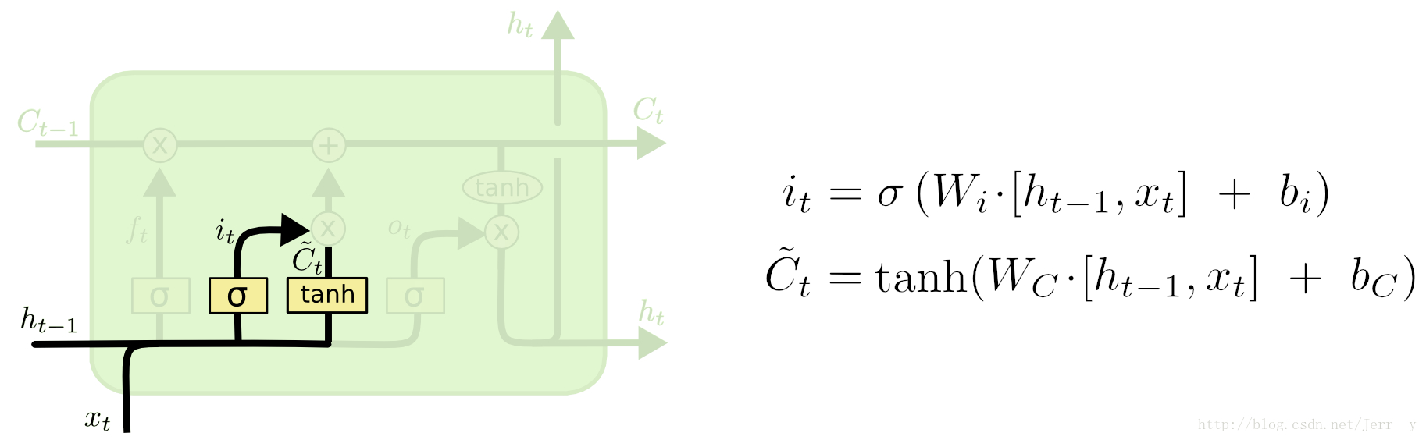

input gate
Determine how much new information should be added to the cell.
The sigmoid layer determines what information needs to be updated: It
A vector generated by tanh layer: ~Ct
Merge 1 and 2: It * ~Ct, Ct = Ft * Ct-1 + It * ~Ct
Notes:
The next step is to decide what new information we’re going to store in the cell state. This has two parts. First, a sigmoid layer called the “input gate layer” decides which values we’ll update. Next, a tanh layer creates a vector of new candidate values, C~tC~t, that could be added to the state. In the next step, we’ll combine these two to create an update to the state. In the example of our language model, we’d want to add the gender of the new subject to the cell state, to replace the old one we’re forgetting.
It’s now time to update the old cell state, Ct−1Ct−1, into the new cell state CtCt. The previous steps already decided what to do, we just need to actually do it.
We multiply the old state by ftft, forgetting the things we decided to forget earlier. Then we add it∗C~tit∗C~t. This is the new candidate values, scaled by how much we decided to update each state value.
In the case of the language model, this is where we’d actually drop the information about the old subject’s gender and add the new information, as we decided in the previous steps.

Slide 15
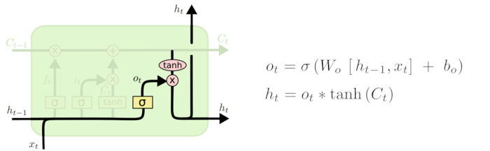
output gate
Determine what value we should output based on the cell
Run sigmoid function to determine what portion should be output
Process the cell with tanh function to get value between -1 and 1, then multiply it with sigmoid
Notes:
Finally, we need to decide what we’re going to output. This output will be based on our cell state, but will be a filtered version. First, we run a sigmoid layer which decides what parts of the cell state we’re going to output. Then, we put the cell state through tanhtanh (to push the values to be between −1−1 and 11) and multiply it by the output of the sigmoid gate, so that we only output the parts we decided to.
For the language model example, since it just saw a subject, it might want to output information relevant to a verb, in case that’s what is coming next. For example, it might output whether the subject is singular or plural, so that we know what form a verb should be conjugated into if that’s what follows next.

Slide 16
OutLine
Recurrent Neural Networks
How does RNN works
How Long Short-Term Memory works in stock market
Methodology & Development
Evaluation
Conclusion

Slide 17
METHODOLOGY & DEVELOPMENT
Notes:
A classification model was designed based on LSTM networks so as to perform predictions of price movements for a number of stocks. In other words, it attempts to determine if the price of a particular stock will be higher or not than the current price in 15 minutes in the future. That model is regenerated and trained each trading day on top of historic price data and it is used for performing predictions each 15 minutes using the same model and weights until the end of the day. We can think of price data as yesterday’s food, those technical indicators as today’s weather.

Slide 18
Data processing
The log-return transformation can be expressed as (1):
log(pi) − log(pi−1)
In order to reduce random variation and noise on the pricing series, exponential smoothing was performed through exponentially weighted moving averages:
zi = λ¯xi + (1 − λ)zi−1
For determining the class, the policy to set the value will be based on whether or not the closing price of the next period will be higher than the current one:
y = 1 if closej > closei, 0 if closej ≤ closei
Notes:
Historic price data for particular stocks are gathered in the format of a time series of candles (open, close, high, low and volume) in a granularity of 15 minutes. With the data in hand, a log-return transformation is performed as means of normalization as well as to stabilize the mean and variance along the time series.
A set of technical indicators is generated using the TA-Lib1 library. Such indicators are mathematical calculations intended to determine or predict characteristics from stocks based on their historic data. A total of 175 values are generated for each period, and they are intended to represent or predict a very diverse set of characteristics of the stock, like the future price, volume to be traded, the intensity of the current movement tendency, visual graphical patterns, among others.
A binary class y is assigned to each entry of the dataset, ”1” will indicate that the price will go up on the following time step, and ”0” that it won’t. Therefore, given that i is the current moment and j is the following, then j = i+timestep, and for this project timestep is equivalent to 15 minutes. In case the output is ”1”, a ”buy” operation will be triggered at i.
The neural network will take k instances of X as input (Xi−k, ...,Xi−2,Xi−1,Xi), where X consists in tuples of price data along with technical indicators, and that will be used to predict yj .

Slide 19
OutLine
Recurrent Neural Networks
How does RNN works
How Long Short-Term Memory works in stock market
Methodology & Development
Evaluation
Conclusion

Slide 20
LSTM neural network (Long short term memory) Model
Google’s TensorFlow 2 was used to build the model, which consists of a LSTM input layer, that will take both technical indicators and pricing data as input and will feed an output layer using sigmoid activation
S(t) =1 / (1 + e^-t)
Notes:
The input layers has a dimensionality of 180 features, that consists of the set of technical indicators (all of those generated by TA-Lib) plus the price return data (open, close, minimum, maximum) and volume. It will have an output using the tanh function and that will be connected to the network’s output layer through 20 connections.

Slide 21
Trading operations
When the predicted class is ”1”, in other words, in the case that the network predicts that the stock price will go up, then the strategy is to open a ”buy” position on the current moment (i) and close it on j. In that case, profit was defined as close(j)−close(i).
The financial results were calculated based on hypothetical trades of sets of a hundred stocks per operation disregarding costs and taxes.
Baselines

Slide 22
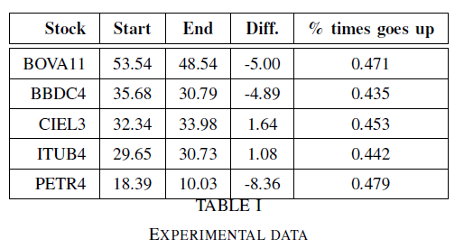
Stock data
Experiments were carried out to predict price movement during December 2014 for the aforementioned stocks and following the methodology described on this article. The results presented below are an average of all executions per each stock.
Notes:
This table presents a characterization of the data used for the experiments, for each stock it has the price that it has on the first day of the period, and what it was on the last day. It also shows the percent of times that the price goes up which is basically the class distribution.

Slide 23
Network performance
For evaluating the network performance, metrics around the algorithm performance and the financial results were collected and compared with the baselines selected for this project.
Accuracy: A = (tp + tn) / (tp + fp + tn + fn)
Precision: P = tp / (tp + fp)
Recall: R = tp / (tp + fn)
Fmeasure: F1 = 2 ∗ P ∗ R / (P + R)
true positives – tp, true negatives – tn, false positive – fp, false negative – fn
Notes:
Those metrics are calculated based on the predictions correctly made for positive classes (true positives - tp), negative classes (true negatives - tn) and those made inaccurately for both classes (false positive - fp, false negative - fn).

Slide 24
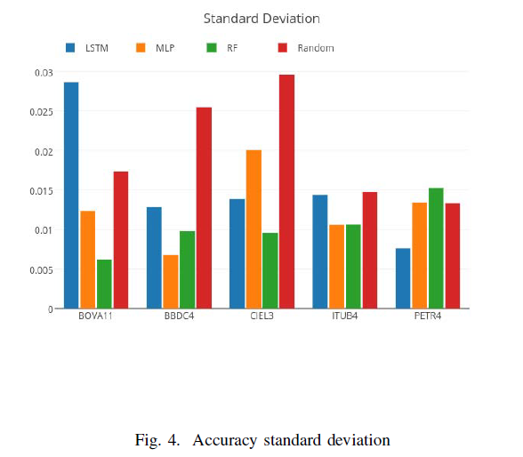
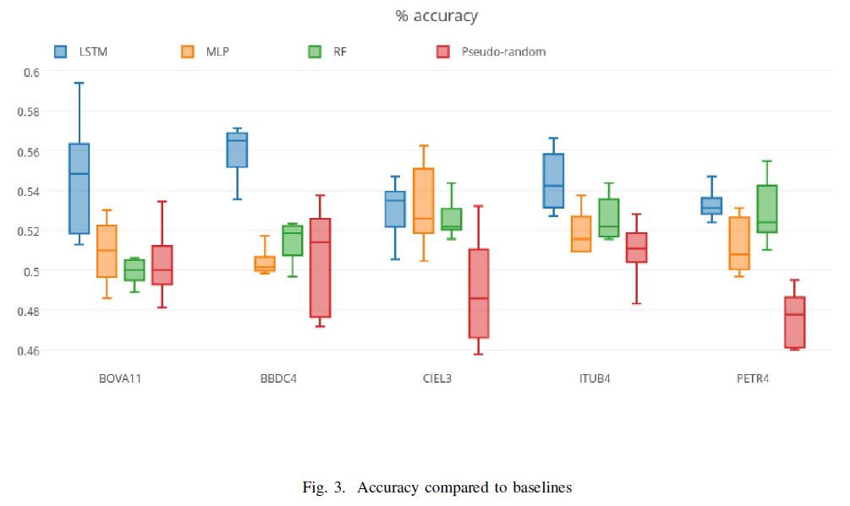
Baselines for % accuracy & standard deviation
Baselines
Notes:
For comparison, the baselines chosen are based on other classical machine learning algorithms in addition to other simplistic investment methods. The machine learning methods consist of approaches that are traditional and widely used but less complex than the one this project is based on. Using the exact same input, trying to do the same predictions, the models chosen were Multi-Layer Perceptron, Random Forest, and a pseudo-random model that outputs a class based on probabilities following the class distribution. The first figure compares it to MLP and Random Forest baselines in terms of accuracy, showing that it outperforms both on average. And The second figure presents the standard deviation for a number of experiments on each of the models to give an understanding of the variance and consistency of each model.

Slide 25
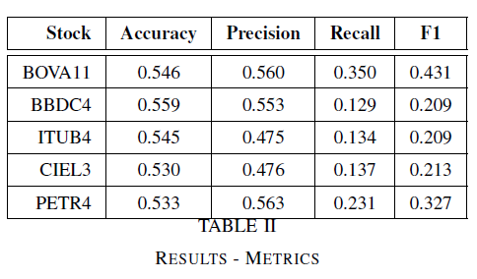
Baselines for % accuracy
Baselines
Notes:
This first table shows that tmetrics of the algorithm prediction performance are shown for each of the stocks, that tells how well it does as a prediction model for different stocks. In order to determine if there is significant improvement in terms of accuracy when comparing the proposed model to the baselines we executed a statistical test on top of the results. The method chosen for that task is Kruskal-Wallis, which is a non-parametric test to compare multiple populations that do not assume that the values are normally distributed. The statistical Test of Kruskal-Wallis shown the results of the statistical tests on the results of the LSTM based model compared to other machine learning methods. The model has shown significant superiority for most occurrences, with a p-value smaller than 0.05.

Slide 26
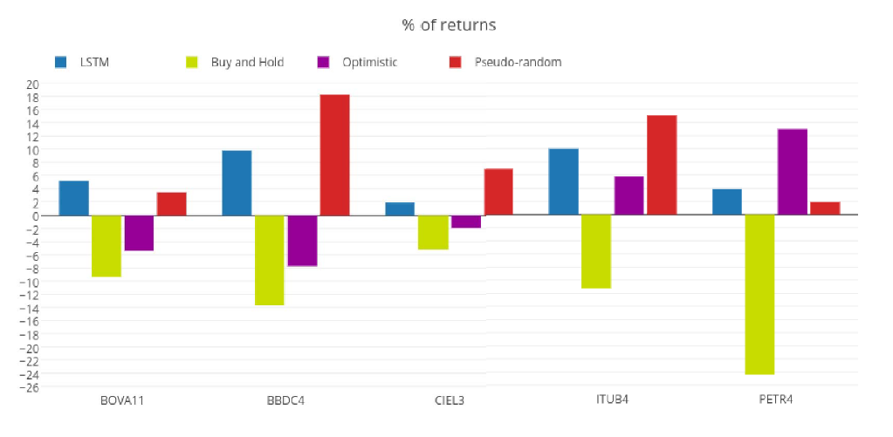
% of Returns
Notes:
This figure displays the average financial returns for the experiments per each stock, compared to each of the investment baselines that were used for this work.

Slide 27
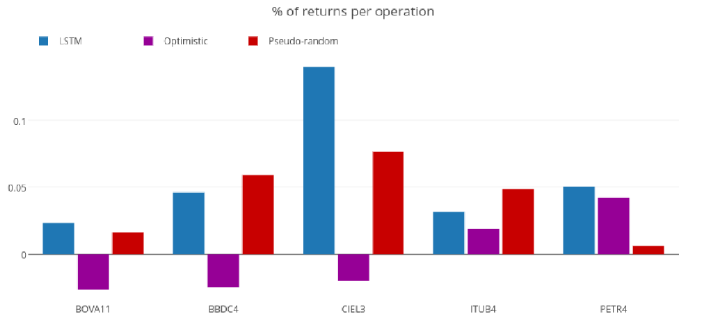
% of returns per operations
Notes:
This figure shows the average earnings per individual buy-and-sell operation.

Slide 28
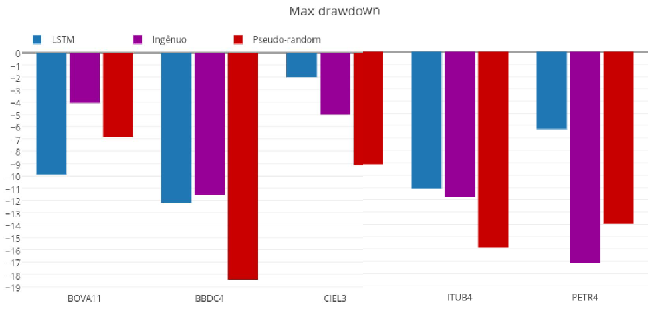
Max drawdown
Notes:
This figure shows the maximum drawdown for each of the strategies. It works as a downside risk metric, presenting the maximum losses from a peak that were faced by the
algorithms during the execution. In that case, it indicates potential for losses of each method and stock combination, and for most of them the LSTM has provided better results.

Slide 29
OutLine
Recurrent Neural Networks
How does RNN works
How Long Short-Term Memory works in stock market
Methodology & Development
Evaluation
Conclusion
Notes:
We can observe that in general the model proposed on this paper outperforms the baselines with few exceptions. The outcomes can be considered very promising as it has proven able to predict well compared to other approaches employed today in the literature. Another positive aspect is that it had a high return ratio per operation, meaning that it had more success on detecting high variations which is extremely important when account transactions costs and taxes are taken into account. Besides that, when observing the maximum losses it is possible to conclude that the LSTM based model offers less risks when compared to the other strategies.

